Slide 1

Portfolio Python (P3 )– Cubed
By: Fran KAMAHA and Steve VOGEL
To: Paul Anthon

Slide 2
Disclaimer None of the contents of this presentation, written or verbal to be construed or considered to be or used as tax or investment advice.
Python PORTFOLIo Project aka “P Cubed”

Slide 3
Portfolio Python (P3 )– Our Story
Francoise
Steve

Slide 4
Portfolio Python (P3 )– Project Summary

Slide 5
Portfolio Python (P3 )– Our Model
Calculate Current Value of the Investor’s Stock Portfolio.
Measure past year returns of Portfolio to VS Benchmarks, e.g., Nasdaq (IXIC), S&P 500 (INX), Nasdaq100 (QQQ) and Investors target 10%.
Tell me how the Proposed Portfolio did during the past year? The Proposed Portfolio contains uneven amount in dollar value of Apple (AAPL) Google (GOOG), Netflix (NTFX), and (NVDA)
Disclose the relevant risks of the current portfolio (“Anthon Portfolio”) vs the Benchmarks and those of the proposed portfolio.
Will the Proposed Portfolio likely move in accordance with the benchmarks?

Slide 6
Portfolio Python (P3 )– Client’s Portrait – Interview for Portfolio analysis - 1
Demographics | Finance : current | Comments : Future
64 Years old | Annual Income: 100 K | Projected Social Security Monthly 2.8K
Married, 3 dependents | Home Value: 400K | Homes appreciating 2% annually
BS in Finance (has not yet studied Python nor pandas) | Mortgage owed: 200K Monthly payment $1,900 | 4-5 years into a 15 year mortgage @ 2.75%
Excellent Health | Annual Spending: 100K | Plays in league bowling and softball
Morgan Stanley Advisor(MS) | Savings: Stock, IRA, Pension | Largest asset IRA now managed by MS
Proposed retirement date : 11/1/2024 | Monthly Mortgage: 1.9K | Retirement Net Worth Required : 1, 500K

Slide 7
Portfolio Python (P3 )– Client’s Portrait – Interview for Portfolio analysis - 2
Current Portfolio Composition | Proposed Portfolio Composition | Curious about Crypto Thoughts for future | Benchmarks
ADP : 1000 shares (from former employer from 24 yrs.) | NVDA, GOOG | Future BTC | BRR-B
BR: 500 Shares | NFLX | Or ETH | S&P 500
CDK: 950 shares | AAPL | Or DODG | NASDAQ IXIC
IRA value: 800K Diversified (+averaged 10% over past four years, 20% in past year) | None this proposal, seeking details if current proposal is successful | Portfolio TBD, stocks, bonds, cryptocurrencies and perhaps NTF’s (birthcake, wedding cake) | N100 - QQQM

Slide 8
ANALYSIS

Slide 9
CURRENT PORTFOLIO

Slide 10
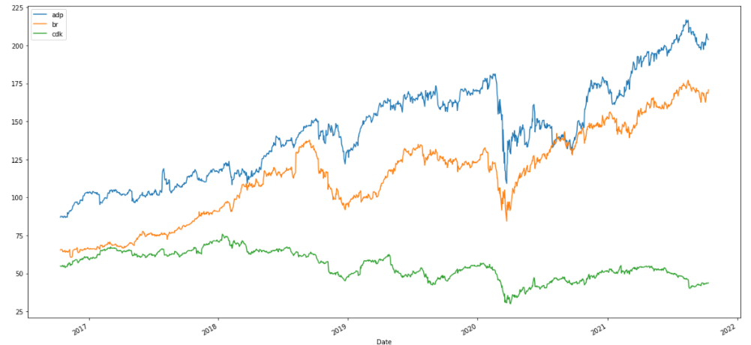
Portfolio Python (P3 )– Current Portfolio - Daily Returns

Slide 11
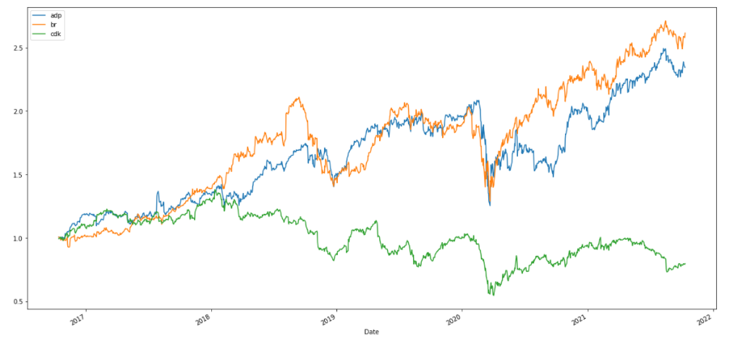
Portfolio Python (P3 )– Current Portfolio - Cumulative Returns

Slide 12
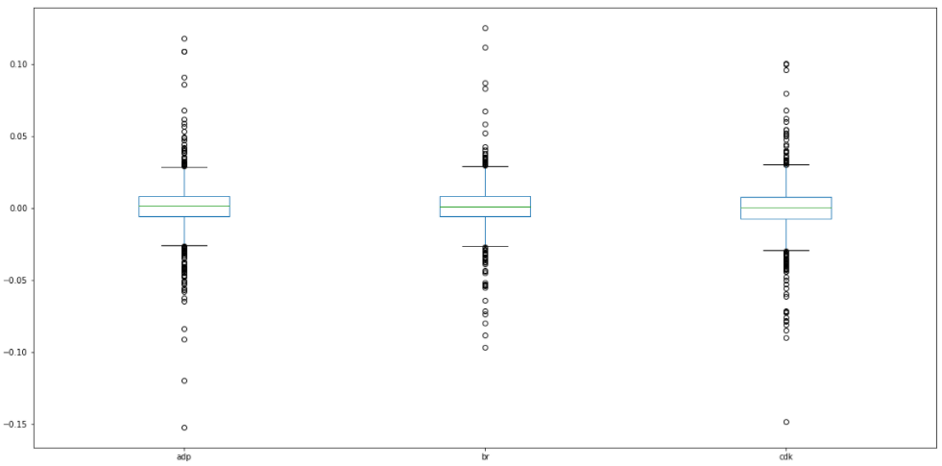
Portfolio Python (P3 )– Current Portfolio – Risk Exposure

Slide 13
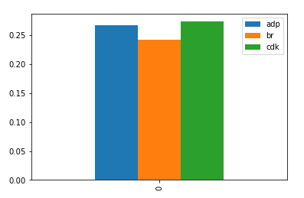
Portfolio Python (P3 )– Current Portfolio – Annual STD

Slide 14
PROPOSED PORTFOLIO

Slide 15
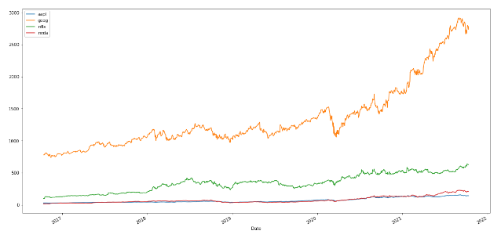
Portfolio Python (P3 )– Proposed Portfolio - CumDaily Returns

Slide 16
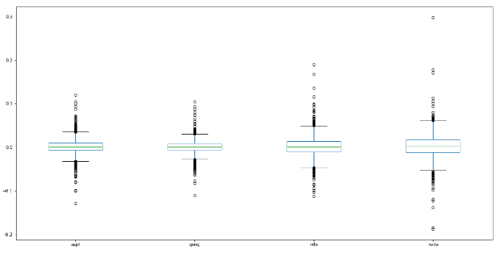
Portfolio Python (P3 )– Proposed Portfolio – Risk Exposure

Slide 17
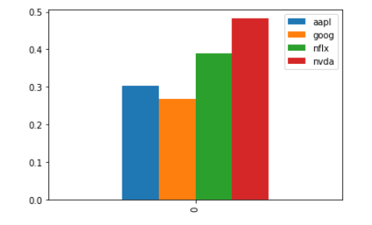
Portfolio Python (P3 )– Proposed Portfolio – Annual STD

Slide 18
Results at Retirement
 | Anthon Portfolio | Anthon Projected
 | Sep-21 | Sep-24
Stocks (adp,br,cdk) | 333,000 | 467,841
Emergency Funds(mm) | 65,000 | 66,970
IRA (Morgan Stanley) | 813,074 | 1,082,201
Net Equity in Home | 200,000 | 274,483
Net Equity | 1,411,074 | 1,891,495
Proposed Portfolio | 333000 | 506,451
(AAPL,GOOG,NTFX,NVDA) |  | 38,610
Home Value | 400,000
Mortgage | 200,000
Annual Income | 100,000
Annual Spending | 100,000
Social Sec Benefit @ 3 yrs | 2,800
Annual Spending Retirement
Current | 100,000
less Mortgage $1,900 | 22,800
 | 77,200
RESULTS AT RETIREMENT
Annual Income Retirement |  | w/o spouse work
Spouse Income | 40,000
SS 2,800/mo | 33,600 | 33,600
Portfolio Increase | 66,680 | 66,680
Income | 140,280 | 100,280
Spending | 89,369 | 89,369
Net Annual Savings | 50,911 | 10,911

Slide 19
Portfolio Python (P3 )– Proposed Portfolio – Sharpe Ratio
AAPL
GOOG
NFLX
NVDA
Ratio Good
Risks Acceptable
1.1525767137136118

Slide 20
Results at Retirement (page 2)

Slide 21
Conclusion & Recommendations
1. The current portfolio has performed well. ADP is a sound and growing Corporation. Its spin-offs has helped diversify Anthon’s holdings. (Future Birthday Cake and Wedding Cakes will use predictive metrics on both the IRA and Stock Portfolio.)
2. Anthon’s IRA, managed by Morgan Stanley has seen healthy returns, especially during the past two years .P Cubed birthday cake and wedding cake will analyze this portfolio if available.
3. The Anthon’s Portfolio can be replaced by a higher yielding Proposed Portfolio of AAPL, GOOG, NTFX, and NVDA. This provides strong results within the acceptable risk level of the investor.
4. Next steps; At the next investor meeting, reactions to this proposal will be discussed, methods of implementing the requested changes will be discussed, especially with tax consideration in mind and a request for enough details to assess the IRA held with Morgan Stanley will be made.
. A plan for replacement and full analysis of Anthon Portfolio including the IRA will be created and reported in Birthday Cake or Wedding Cake.

Slide 22
Portfolio Python (P3 )– Conclusion
Investments | Estimates | 3 yrs. projection
Portfolio | $333K | $468k
IRA | 813K | 1,082k
Pension ( emergency Fund) | 65K | 66.9K ( 1% growth)
Net Equity in Home | 200K | 274.5K ( 2% growth)
Total Est. Net Worth | $1411k | $1,891k

Slide 23
THANK YOU QUESTIONS?

